Slide 1

ValetAI
PREVIOUS
NEXT
End-to-End Agentic AI Operations Intelligence Platform
Databricks • LangGraph • RAG • LangFuse • Azure
Samridhi Sinha
ASE Intern Accenture

Slide 2

Problem Statement
Operations today are flying blind on the "why."
Business Challenge:
• Structured metrics: missed pickups, completion times, route performance
• Unstructured notes: resident complaints, incidents, root causes
• Traditional dashboards answer "what happened" — not "why it happened"
Objective:
Build an intelligent assistant capable of:
Answering natural language questions
Retrieving exact operational metrics
Identifying historical patterns
Generating actionable recommendations

Slide 3
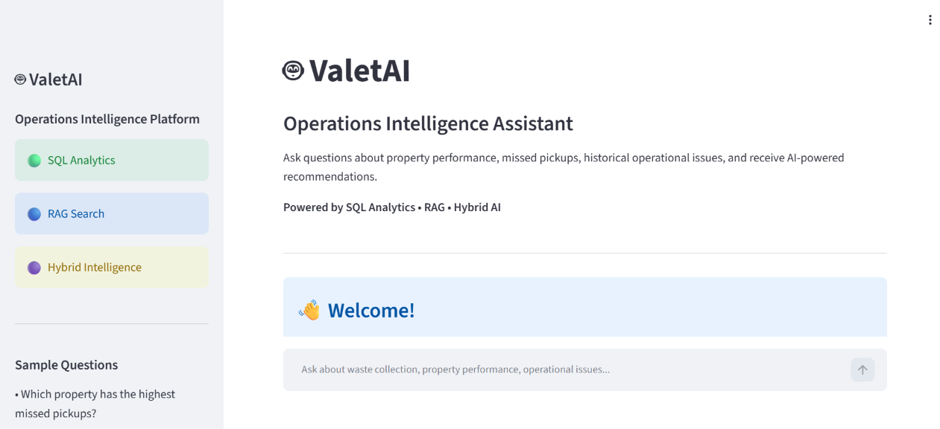
Proposed Solution: ValetAI Operations Intelligence System
One platform for metrics, insights and recommendations.
ValetAI combines structured analytics and Retrieval-Augmented Generation (RAG) within a LangGraph multi-agent workflow.
Natural language interface
Intelligent query routing
SQL Analytics Agent
RAG Resolution Agent
Hybrid reasoning
Executive summaries

Slide 4

Data Engineering Pipeline
Databricks Bronze-Silver-Gold architecture transforms raw operational data into analytics-ready insights:
Raw Operational CSV → Bronze (Raw data) → Silver (Cleaning, Transformation, Standardization) → Gold (Analytics-ready tables) → SQLite Database
Operational Notes → ChromaDB (Vector Store)
Technologies: PySpark transformations • PySpark ETL • Structured & unstructured storage • Medallion Architecture • SQLite Analytics DB • ChromaDB Vector Store
Unified pipeline powering both SQL analytics and RAG retrieval.

Slide 5

Multi-Agent
Architecture
User Question → Router → SQL / RAG / Hybrid → Synthesizer → Final Response
Router Agent (LangGraph)
Classifies each user query and routes it to the appropriate agent pathway: SQL, RAG, or Hybrid.
SQL Agent (SQLite)
Executes structured queries against operational data tables to provide exact analytics and metrics.
RAG Agent (ChromaDB)
RAG Agent performs semantic search over operational notes stored in ChromaDB and documents using vector search to surface contextual insights.
Response Generation Agent
Combines outputs from SQL and RAG agents into a coherent, actionable final response.

Slide 6

DATA ENGINEERING
DATABRICKS · PYSPARK · SQLITE
AI & AGENTS
GROQ LLM · LANGCHAIN · LANGGRAPH · RAG · EMBEDDINGS
Technology
Stack
BACKEND
FASTAPI · PYTHON
FRONTEND
STREAMLIT
A modern, cloud-native stack spanning data engineering, agentic AI, backend services, frontend, observability, and deployment — all orchestrated for intelligent operations.
OBSERVABILITY
LANGFUSE
DEPLOYMENT
AZURE APP SERVICE · GITHUB · GitHub Actions · Dockerfile

Slide 7

System Workflow
End-to-end execution steps for user queries — from input to intelligent response delivery.
1
STEP 1
2
STEP 2
3
STEP 3
The user submits a natural language question through the Streamlit interface.
FastAPI forwards the request to LangGraph.
The Router Agent determines whether the query is SQL, RAG, or Hybrid.
4
STEP 4
5
STEP 5
6
STEP 6
The corresponding agents retrieve structured analytics or semantic knowledge.
The Response Synthesizer combines all results into one final response.
LangFuse records the complete execution trace for observability. Finally, the answer is returned to the frontend.

Slide 8
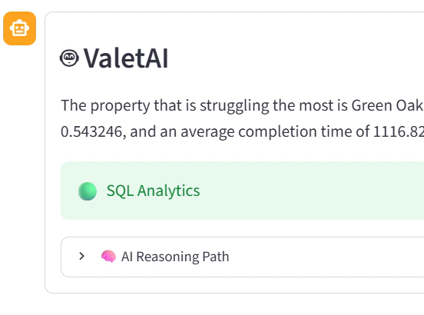
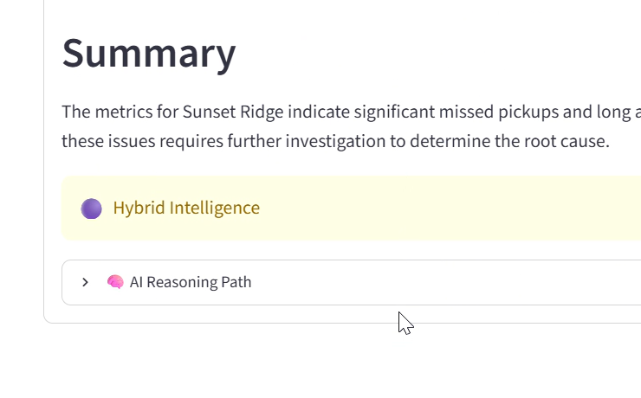
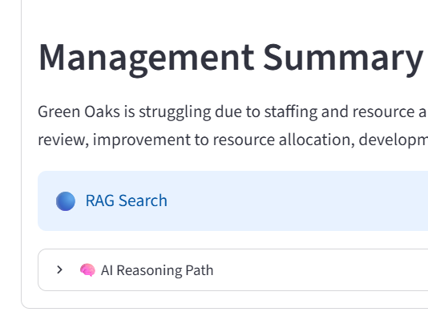
Demo
Live demonstration of ValetAI query capabilities across SQL, RAG, and Hybrid agent routing workflows.
SQL
RAG
Hybrid
"Which property has the highest missed pickups?"
"Which property should management prioritize and why?"
"Generate an executive summary for Sunset Ridge."

Slide 9

Outcomes & Learnings
1
Multi-Agent AI Application
Key achievements and skills acquired throughout the ValetAI project development and deployment.
Built a complete multi-agent AI application combining SQL Analytics and RAG for intelligent operational insights.
2
LangGraph & LangFuse
Implemented LangGraph multi-agent orchestration with LangFuse observability for end-to-end tracing and monitoring.
3
Full-Stack Cloud Deployment
Developed FastAPI backend and Streamlit frontend, successfully deployed on Azure App Service with GitHub CI/CD.

Slide 10

Skills Acquired
Key competencies and technologies mastered throughout the ValetAI project development.
Technical & AI Expertise
• Databricks Data Engineering
• Agentic AI & LangGraph
• RAG Architecture
• Vector Databases
• LLM Prompt Engineering
• API Development
• GitHub Actions CI/CD
• Cloud Deployment
• AI Observability

Slide 11
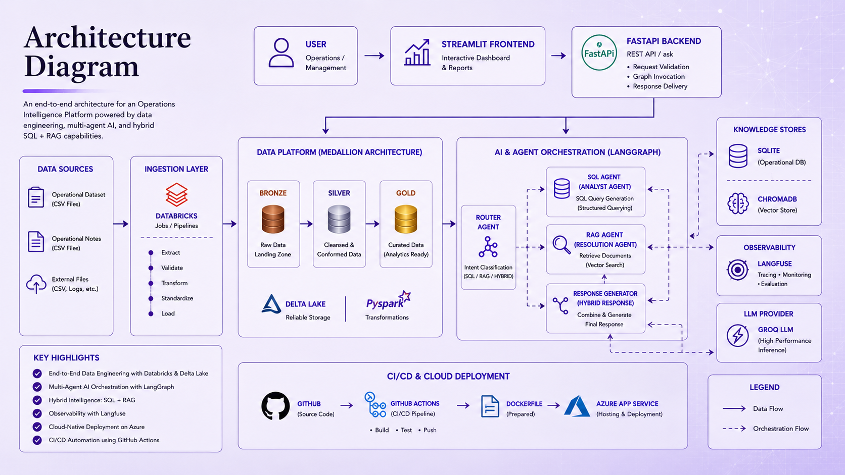
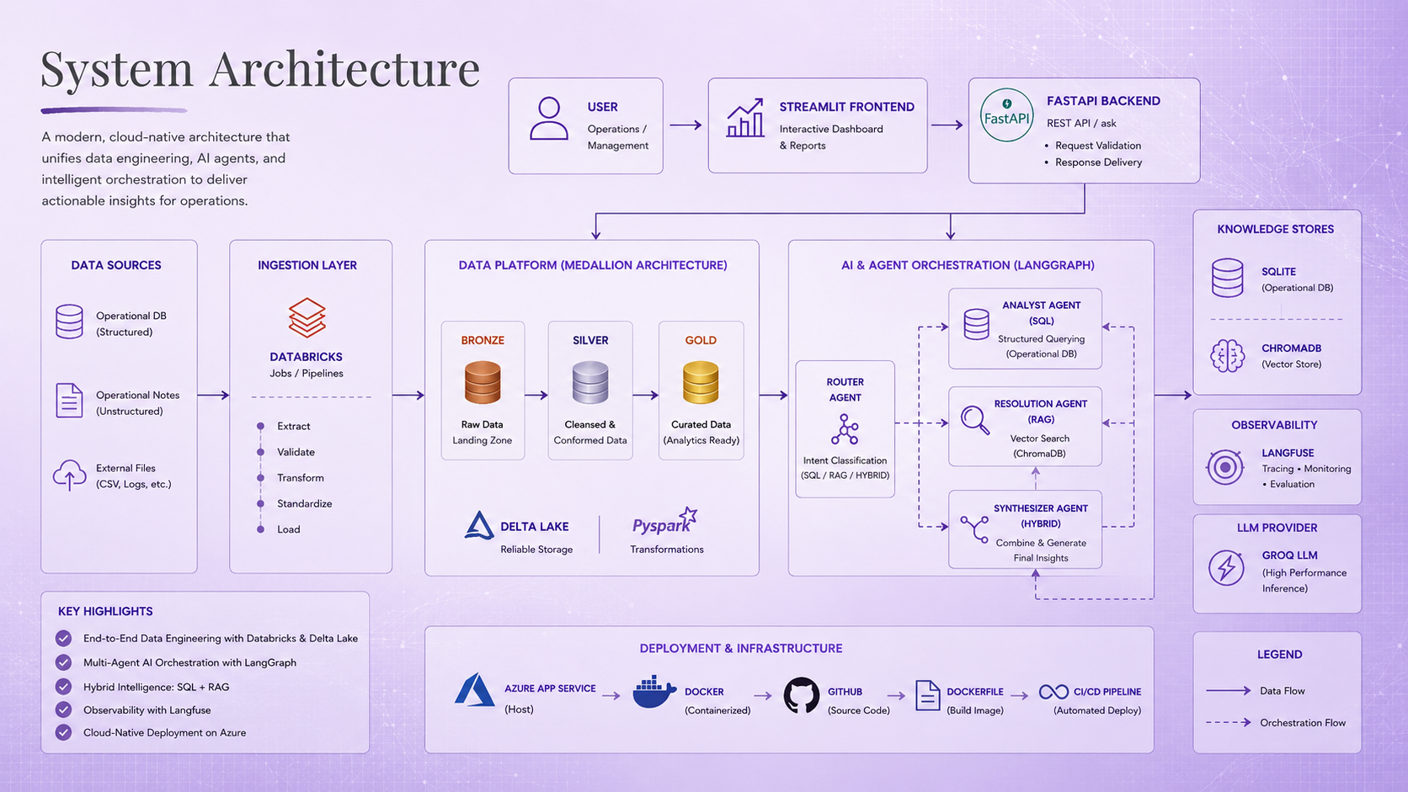
Architecture Diagram

Slide 12

ACCENTURE
Samridhi Sinha
VALETAI
END
Thank You
ValetAI — Intelligent Operations Insights using Multi-Agent AI

